Slide 1
Nolan Smith
Director of Finance
New World, New Numbers
1 December 2016

Slide 2



The English HE policy landscape
The Higher Education and Research Bill
OfS and UKRI
‘Schools that work for everyone’ Green Paper
Brexit
Industrial Strategy & Autumn Statement
“Place” and devolution
TEF

Slide 3

Financial health of the sector: 2016 Report
Current position is overall ‘sound’
Significant variation in future financial projections
Sector surpluses between 2.3 per cent and 4.3 per cent of income
Increasing reliance on overseas fee income and growth in Home students
Forecasts do not yet reflect the likely impacts of Brexit
Trend of falling liquidity and increasing borrowing continues
Increasing backlog of estates maintenance

Slide 4
Operating surplus/surplus as a % of total income 2014-15

Slide 5
Discretionary/Unrestricted reserves (including pension provision) as a % of total income 2014-15

Slide 6
Net liquidity days 2014-15

Slide 7
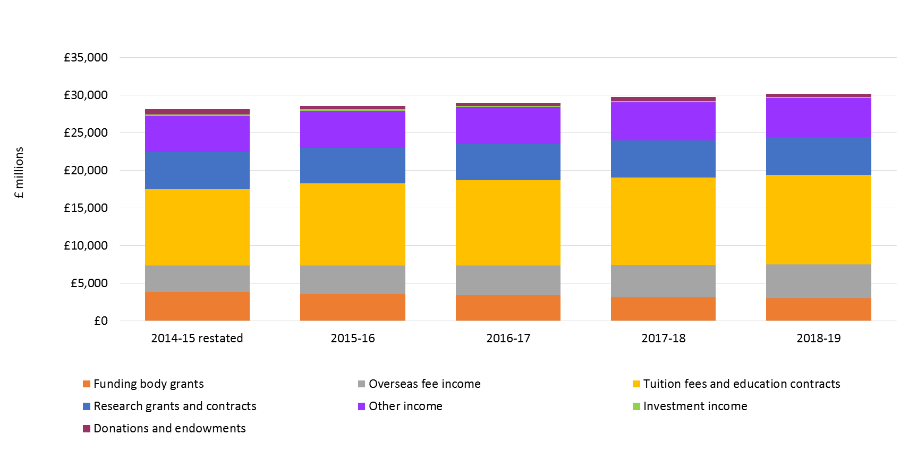
Income (real terms)

Slide 8
Teaching income (real terms)

Slide 9
Student recruitment
Notes:
This chart compares % change in overseas FTEs vs % change in Home/EU FTEs (2014/15-2018/19)
Sorted by overseas (ascending)
It is Total UG (ft & pt)

Slide 10
Fee income
Outliers excluded
Notes:
This chart compares % change in overseas fee income vs % change in Home/EU fees (2014/15-2018/19)
Sorted by overseas ascending

Slide 11
Real term change overseas fee income 2014-15 to 2018-19
Sector Average 25.9%

Slide 12
Modelling – removal of non-EU fee income growth (2016-17 to 2018-19)

Slide 13
Capital funding and surpluses

Slide 14
Capital expenditure funding breakdown
Notes:
Do you also want a chart referring to backlog maintenance increases?

Slide 15
Capital expenditure as a % of total income, 2015-16
Sector average 14.5%

Slide 16
Liquidity and borrowing

Slide 17
Net debt

Slide 18
External borrowing as a % of total income, 2015-16

Slide 19
Forecast external borrowing as a % of total income, as at 31 July 2016 and 31 July 2019, by TRAC peer group

Slide 20
Pension liabilities 2018-19
Sector average 15.9%
Institutions
Notes:
Pension liabilities as percentage of total net assets (total assets less minus total creditors)

Slide 21
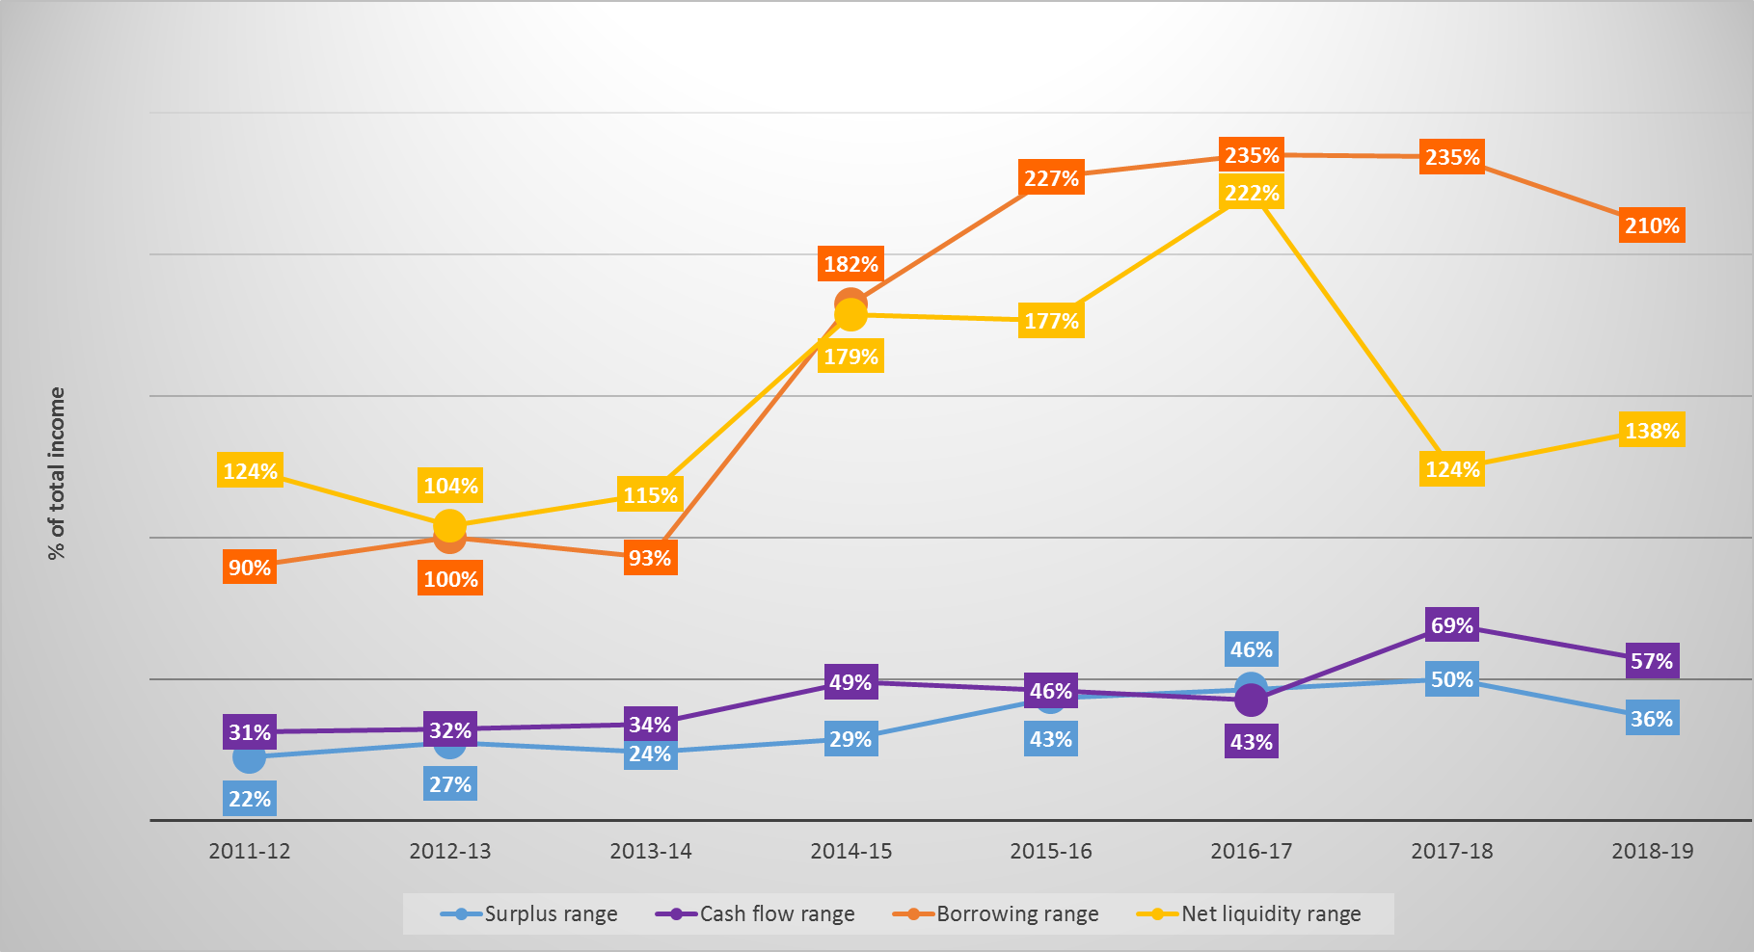
Increasing variation

Slide 22
Range of variability

Slide 23
Thank you for listening
Follow us on Twitter at
http://twitter.com/hefce

